Slide 1


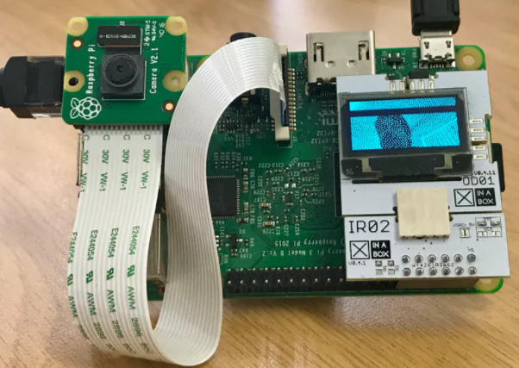
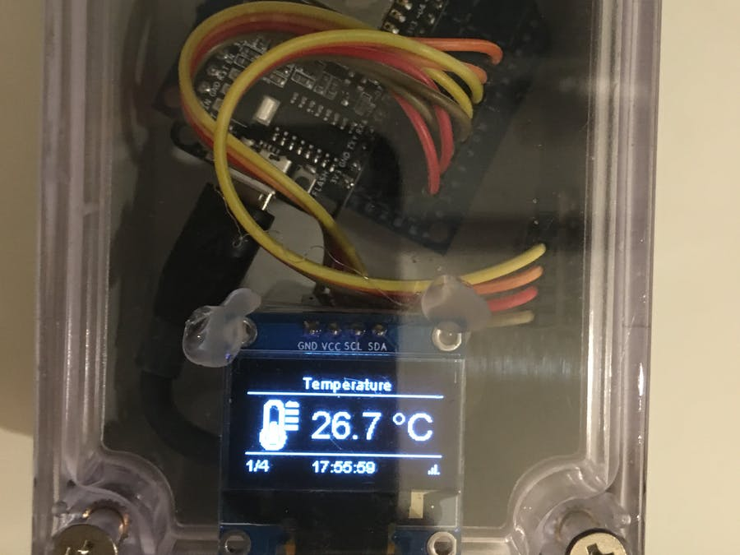
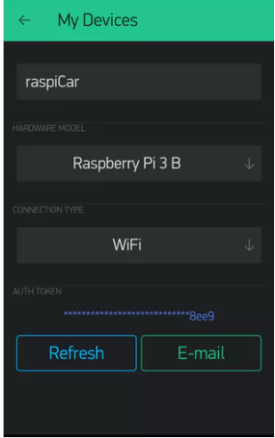
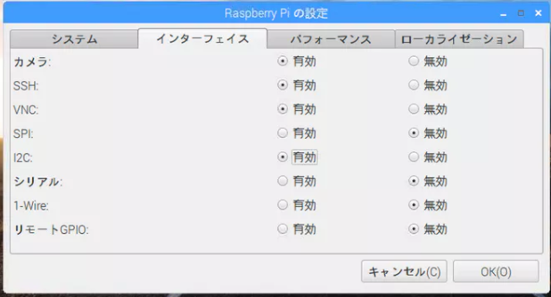
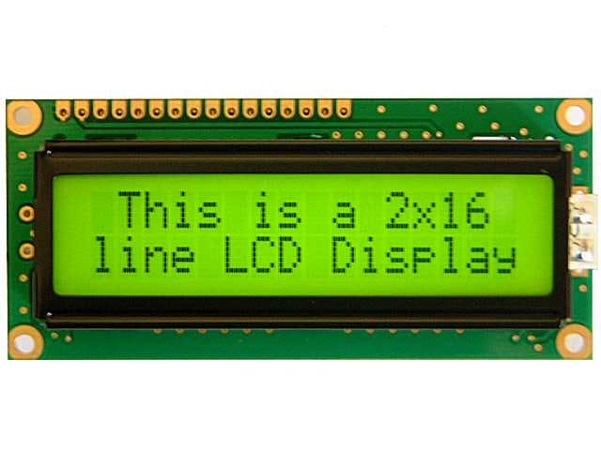
Title of Project
Problem Statement
Graphical Abstract
To develop an apparatus and method that automate water conservation of residential buildings using Internet of Things (IoT) and sensors.
Objectives
To study various sensors and related technologies
To study IoT for efficient communication between sensors and controllers
To develop & deploy low cost sensor based controllers for water conservation
To develop a centralized supervising/monitoring system for water conservation
Model & Methodology
Experimental Setup & Results
.
.
Functional Modules
1. Sensing module
2. Process module
3. Gateway interface module
4. Cloud module
5. GUI module
…
Hardware Components
1. Raspberry Pi Zero Wireless
2. mobile battery
3. DRV8830
4. Adafruit Mini Round Robot Chassis Kit - 2WD with DC Motors
Software Apps
1. Arduino IDE
2. MQTT APP
3. UBIDOT
4. Blynk
Conclusions Team
Configuration
Brief summary of what you discovered based on results
Indicate and explain whether or not the data supports your hypothesis
Give directions for future work in this area.
Each of the areas can be expanded as per requirement
Team Member-1 Name
Work Flow
Team Member2 Name
Team Member-3 Name
Team Member-4 Name
Team Member-5 Name
Dr M Rajasekhara Babu, Guide

